Slide 1

COVID-19 Symptom Data Challenge: CSDC Global Explorer
MIKE HONEY

Slide 2
Case Study – Victoria, Australia
The CSDC Global Explorer solution is extremely flexible; a wide range of analyses are supported.
For the purposes of this presentation, the focus is on the state of Victoria in Australia, and some neighbouring states. During the July-September period, Victoria experienced a “second wave” of COVID-19 infections. The public health response was a strict lockdown within Victoria, and neighbouring states responded with border closures and largely avoided significant infections.
This presentation walks through the pages presented in the CSDC Global Explorer visualisation solution, using their interactive features to quickly explore this topic.

Slide 3
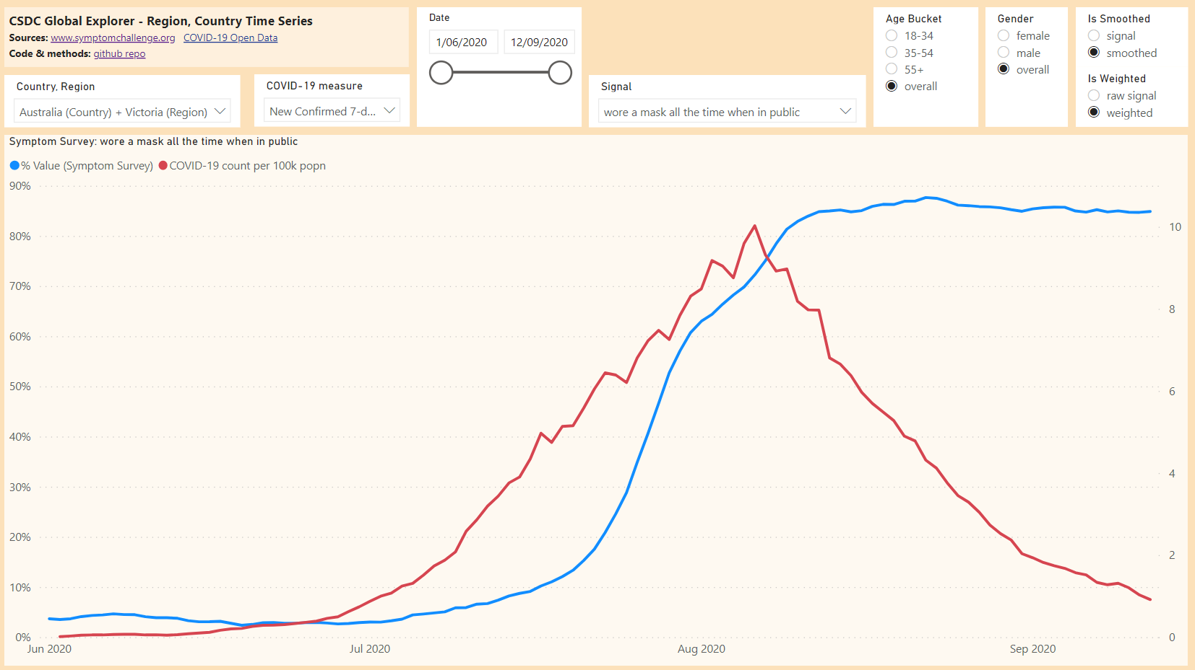
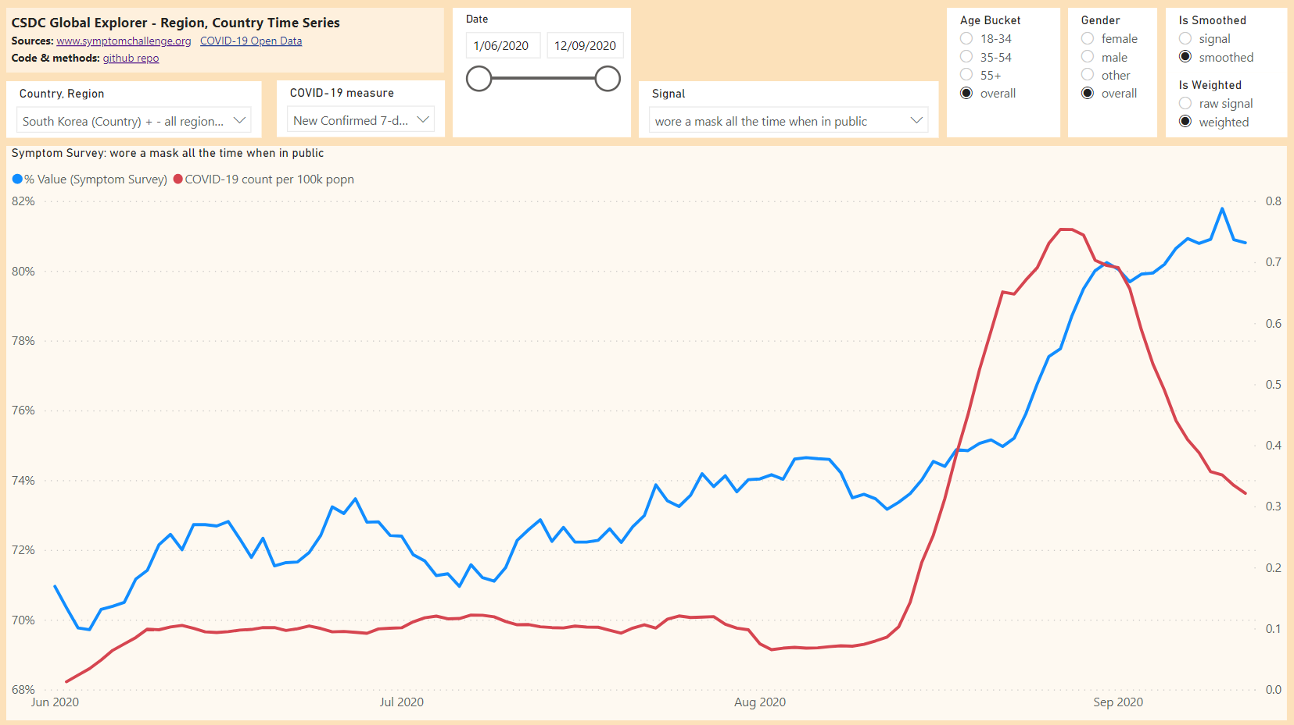
Region, Country Time Series Choose the Signal: wore a mask all the time when in public and the Region: Victoria, Australia. Note as cases rose, mask wearing became widespread, at which point COVID-19 cases dropped steeply. Choose the Region: South Korea – all regions for a similar pattern.

Slide 4
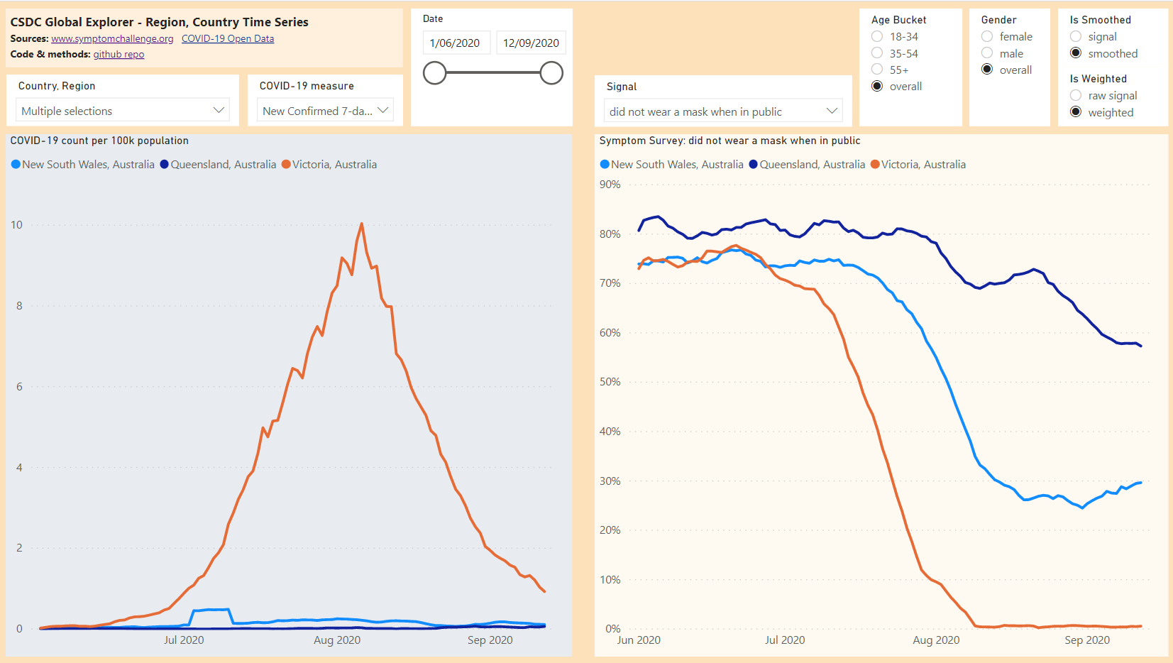
Region, Country (multi) Time Series Choose the Signal: did not wear a mask when in public and the Region: Victoria, Australia and some neighbouring regions. Note the extremely high compliance levels with the public health mandate in Victoria, and lesser changes in other regions.

Slide 5
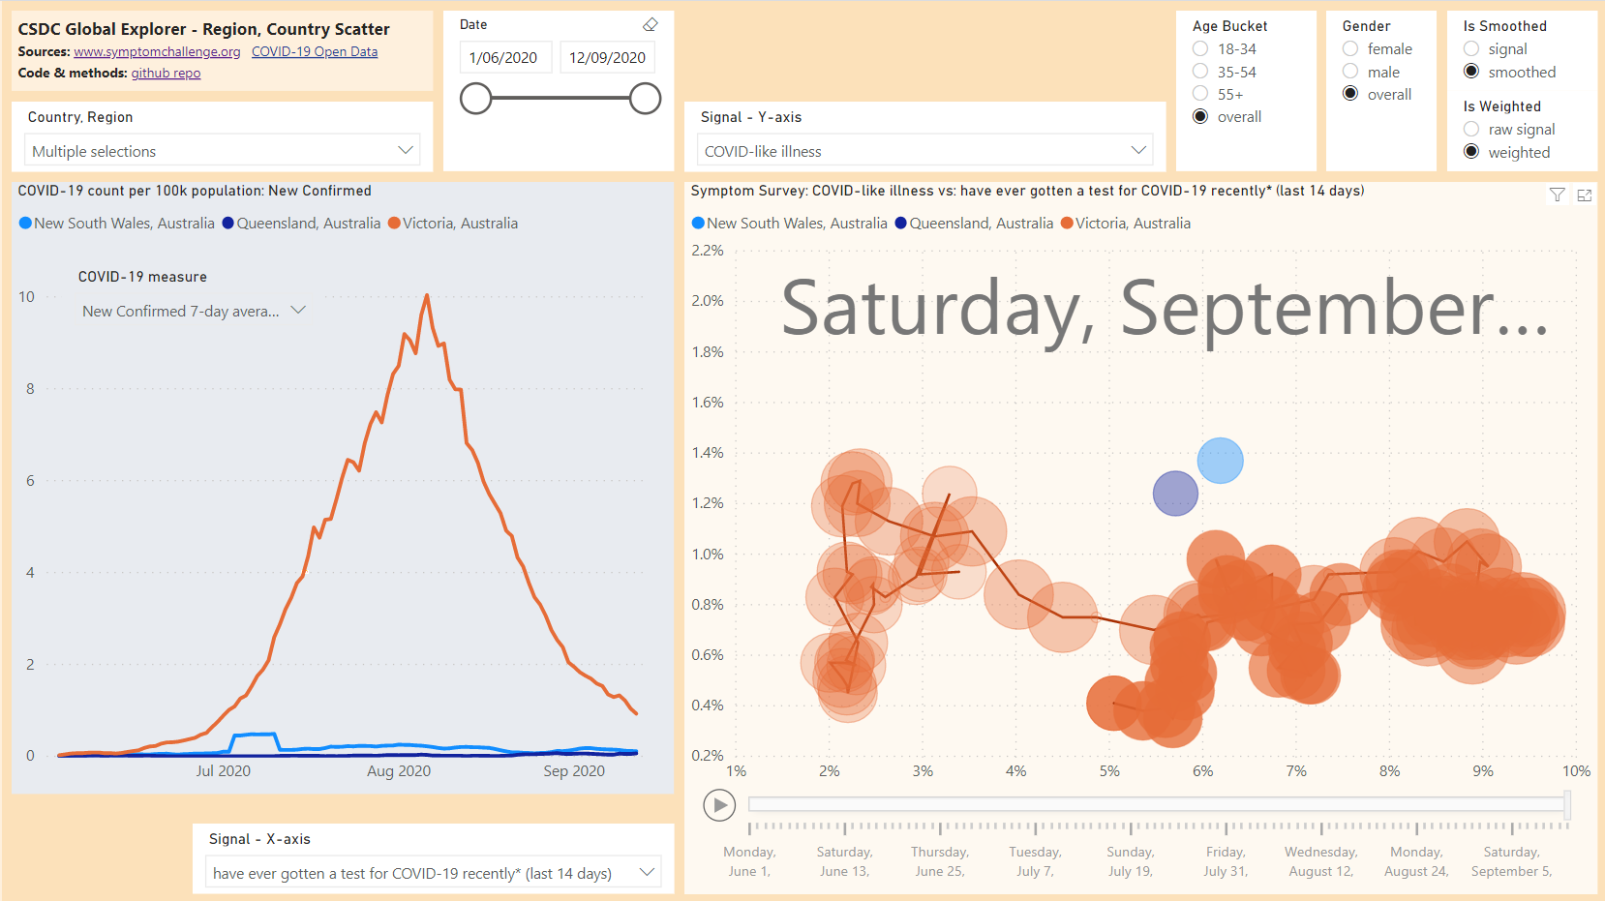
Region, Country Scatter Choose the Signal- Y-Axis: COVID-like illness and the Signal- X-Axis: have ever gotten a test for COVID-19 (last 14 days). The Region, Country selections will be automatically synchronized with those chose on the previous page. Click the Play button (bottom-right) to animate over time. Note the initially higher testing levels in Victoria, although later results converged. The last few days saw a decline in COVID-like illness responses for Victoria.

Slide 6
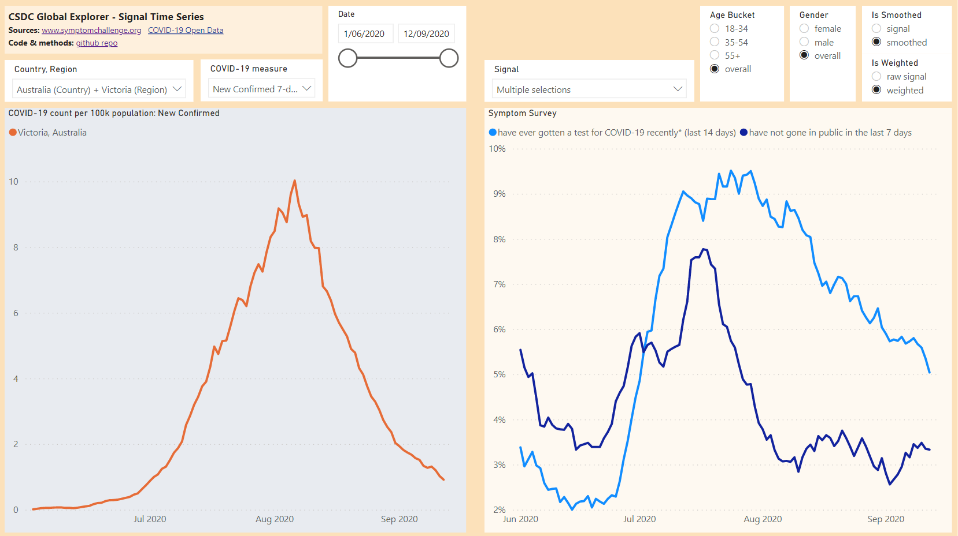
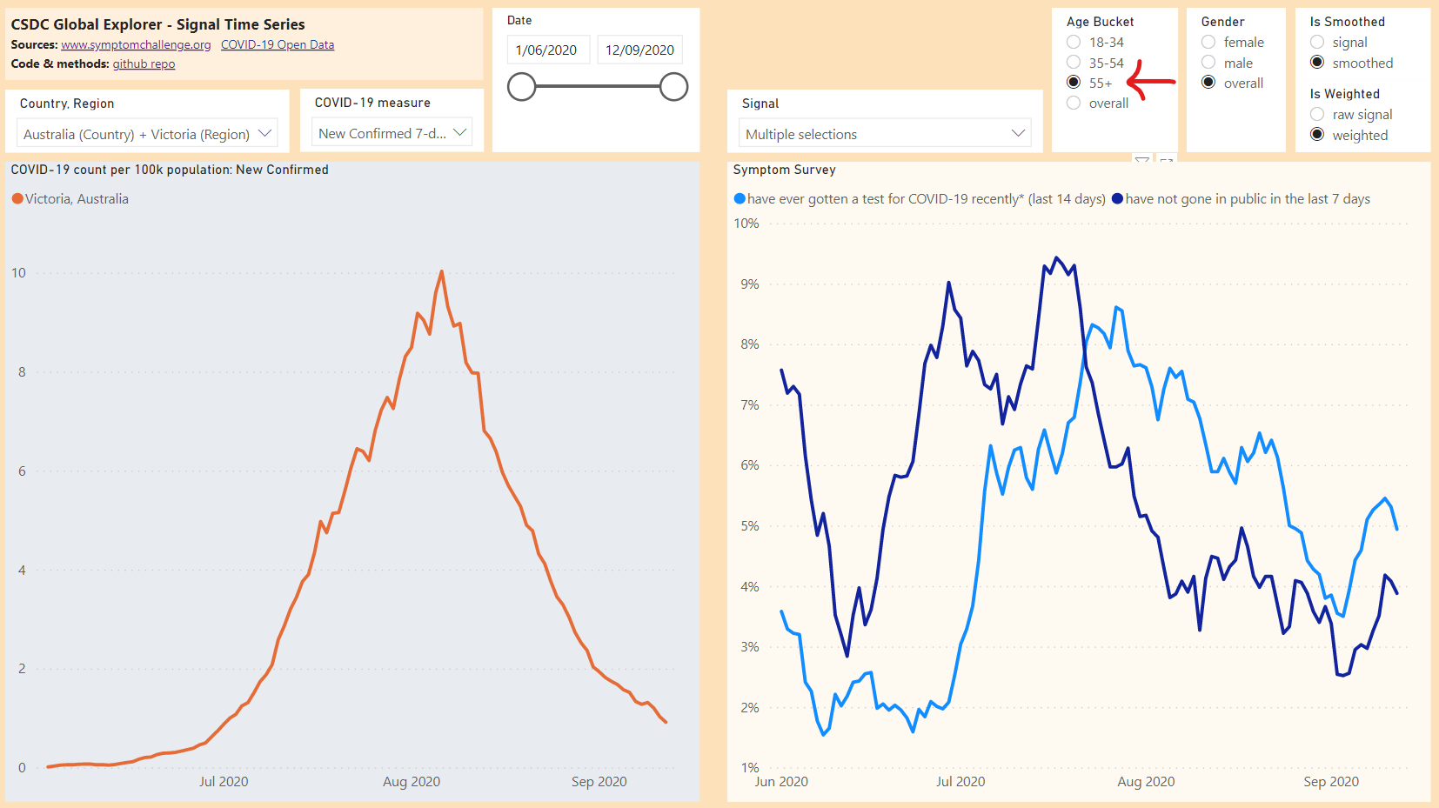
Signal Time Series Choose the Signals: have ever gotten a test for COVID-19 (last 14 days), and have not gone in public for the last 7 days. Choose the Country, Region: Australia / Victoria. Review, then change the Age Bucket from overall to 55. Note the lower uptake of testing by older respondents as cases rose, compared to their higher levels of not going in public.

Slide 7
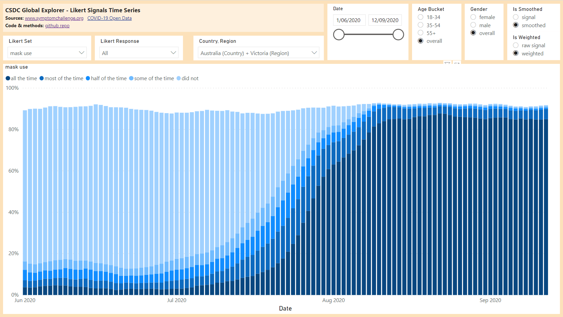
Likert Signals Time Series Choose the Likert set: mask use. Note the increase in mask use mostly pre-dated the August 2 public health mandate. It was sustained by a significant majority.

Slide 8
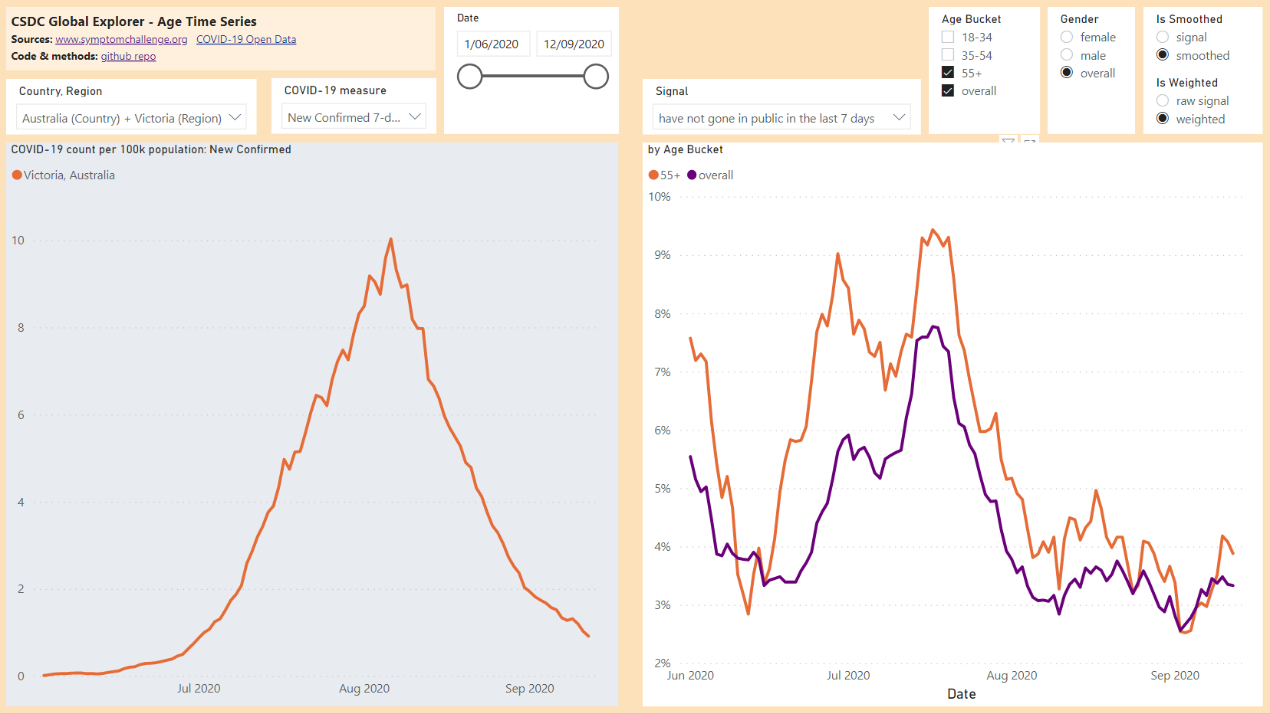
Age Time Series Choose the Signal: have not gone in public in the last 7 days. The display of all Age buckets is a bit noisy. First choose the Age Bucket overall, then 55. Note that older respondents are more likely to report this extreme precaution, compared to the overall population.
Also note that reporting of this behaviour fell as cases fell.

Slide 9
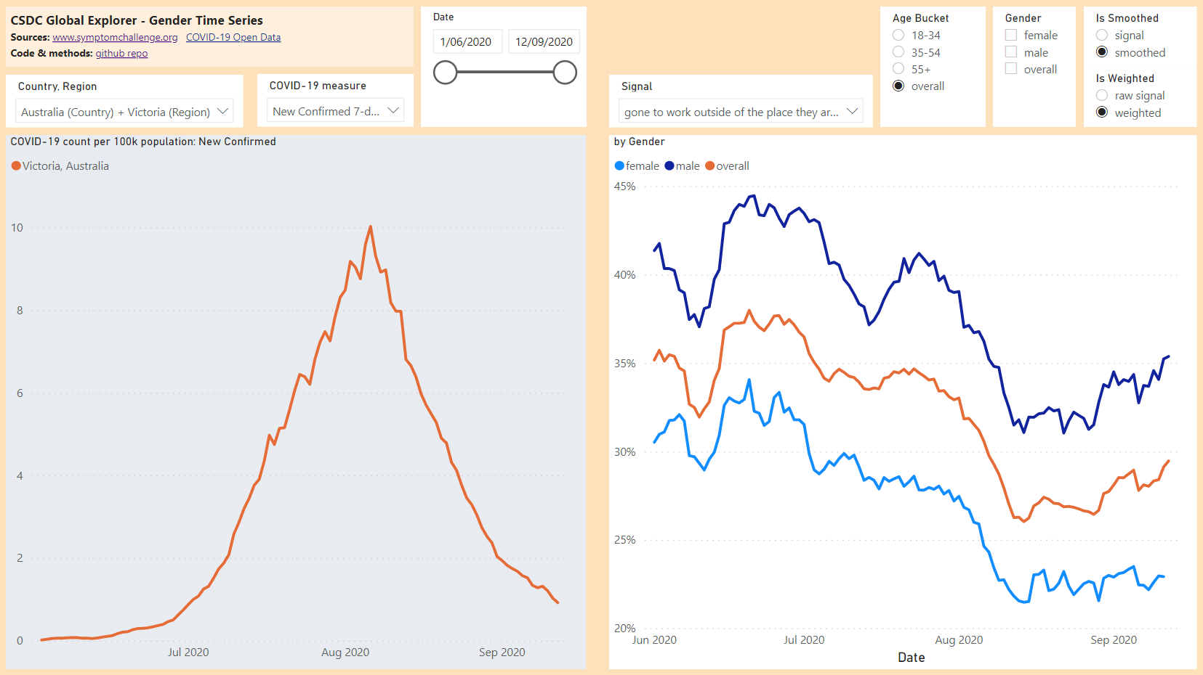
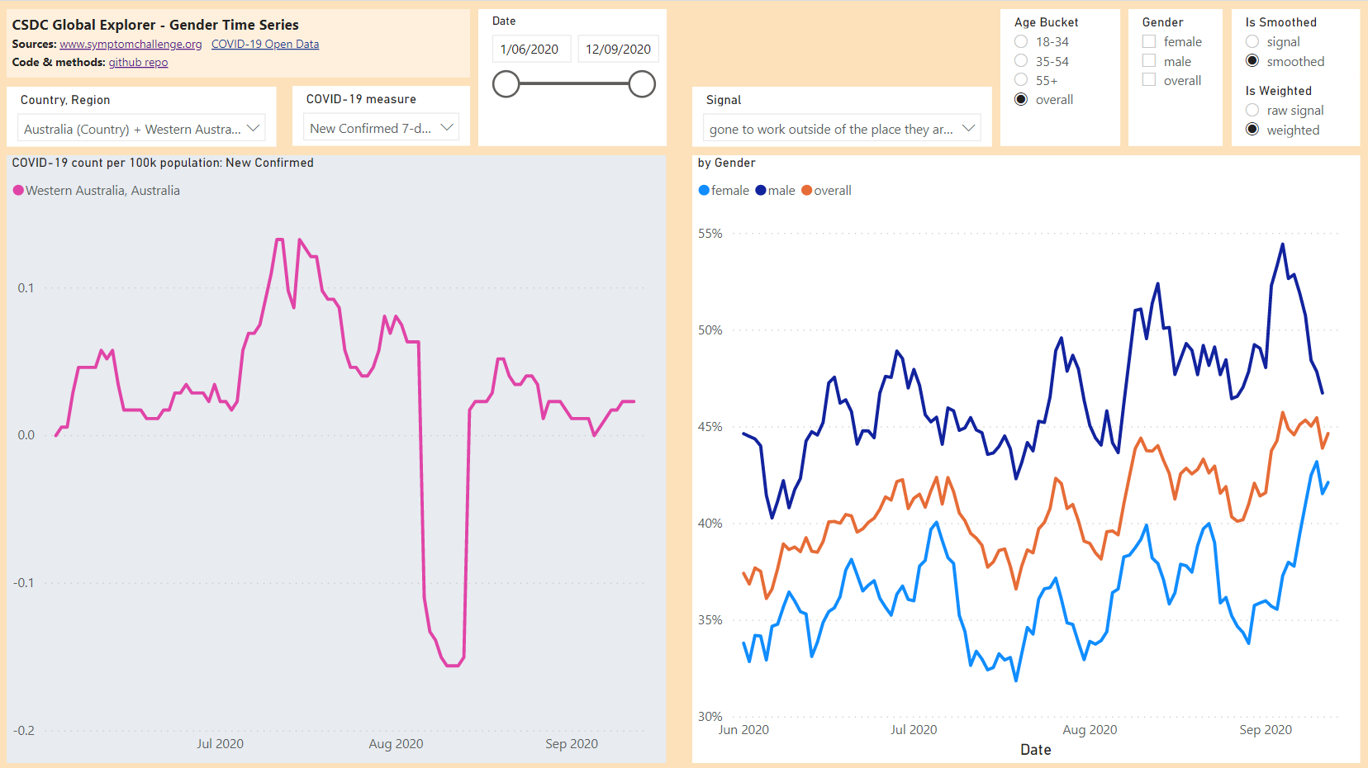
Gender Time Series Choose the Signal: gone to work outside of the place they are staying…. You can quickly compare to other Regions e.g. Western Australia – the % for male seldom is usually in the 40-60% range, vs low 30s in Victoria. You can also explore the variations by Age Bucket etc.

Slide 10
Conclusions
As the dataset is vast and complex, the aim of this solution is to empower those with public health expertise to easily explore and analyse interactively. The CSDC Global Explorer is an interactive tool, so an untrained user can use the report pages to explore almost any aspect of the dataset, using just a web browser, with response times in seconds.
Experience across many scenarios and domains has shown that when subject-matter experts are freed to explore a complex dataset using this approach, they can quickly find meaningful insights or be inspired to dig deeper. Domain experts in public health can quickly compare and contrast survey results from any slice of the survey dataset, helping them quickly understand reported trends.
Use of a fully interactive data visualization platform gives the opportunity for the broadest possible audience to engage and understand the survey data. They do not need any technical understanding of the survey's data structure, or any knowledge of visualization coding or tools.

